Slide 1

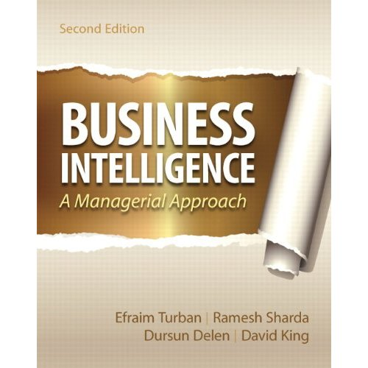
BDM 411 BUSINESS INTELLIGENCE AND ANALYTICS LECTURE 3: BUSINESS INTELLIGENCE AND ANALYTICS
Business Intelligence: A Managerial Approach (2nd Edition)

Slide 2
Learning Objectives
Understand today's turbulent business environment and describe how organizations survive and even excel in such an environment (solving problems and exploiting opportunities)
Understand the need for computerized support of managerial decision making
Describe the business intelligence (BI) methodology and concepts and relate them to decision support systems (DSS)
Understand the issues in implementing BI
Discuss Business Analytics-Processes, steps and use cases

Slide 3
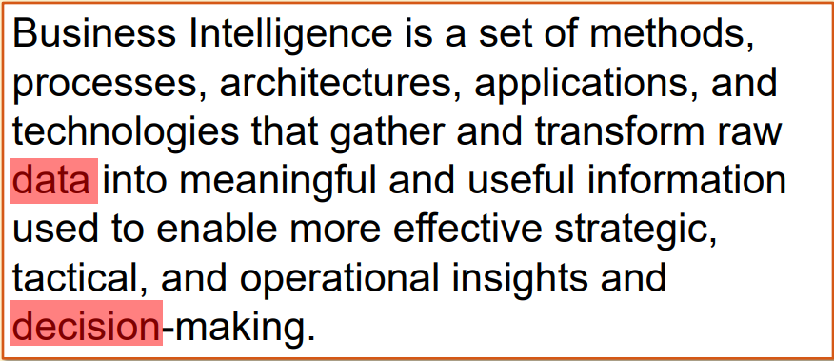
Definition

Slide 4
DEFINITION OF BUSINESS INTELLIGENCE
BI refers to application and technology, which is used to gather, provide access to, and analyze data and information about the company operations
BI is neither a product or a system. It is an architecture and a collection of integrated operational as well as decision-support applications and databases that provide the business community easy access to business data.

Slide 5
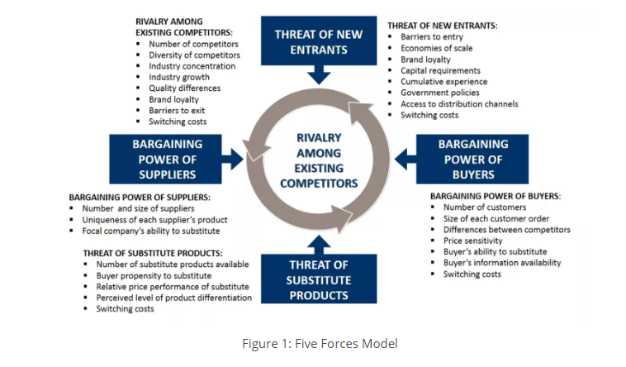
Introduction

Slide 6
Changing Business Environment & Computerized Decision Support
Companies are moving aggressively to computerized support of their operations => Business Intelligence
Business Pressures–Responses–Support Model
Business pressures result of today's competitive business climate
Responses to counter the pressures
Support to better facilitate the process

Slide 7
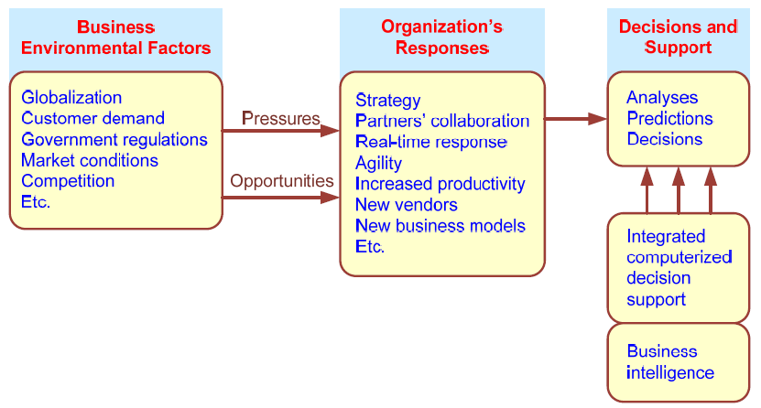
Business Pressures–Responses–Support Model

Slide 8
The Business Environment
The environment in which organizations operate today is becoming more and more complex, creating:
opportunities, and
problems.
Example: globalization.
Business environment factors:
markets, consumer demands, technology, and societal.

Slide 9
Business Environment Factors
FACTOR DESCRIPTION
Markets Strong competition
Expanding global markets
Blooming electronic markets on the Internet
Innovative marketing methods
Opportunities for outsourcing with IT support
Need for real-time, on-demand transactions
Consumer Desire for customization
demand Desire for quality, diversity of products, and speed of delivery
Customers getting powerful and less loyal
Technology More innovations, new products, and new services
Increasing obsolescence rate
Increasing information overload
Social networking, Web 2.0, 3.0 and beyond
Societal Growing government regulations and deregulation
Workforce more diversified, older, and composed of more women Prime concerns of homeland security and terrorist attacks
Necessity of Sarbanes-Oxley Act and other reporting-related legislation Increasing social responsibility of companies
Greater emphasis on sustainability

Slide 10
Organizational Responses
Be Reactive, Anticipative, Adaptive, and Proactive
Managers may take actions, such as:
Employing strategic planning.
Using new and innovative business models.
Restructuring business processes.
Participating in business alliances.
Improving corporate information systems.
Improving partnership relationships.
Encouraging innovation and creativity. …cont…>

Slide 11
Organizational Responses, continued
Improving customer service and relationships.
Moving to electronic commerce (e-commerce).
Moving to make-to-order production and on-demand manufacturing and services.
Using new IT to improve communication, data access (discovery of information), and collaboration.
Responding quickly to competitors' actions (e.g., in pricing, promotions, new products and services).
Automating many tasks of white-collar employees.
Automating certain decision processes.
Improving decision making by employing analytics.

Slide 12
Closing the Strategy Gap
One of the major objectives of computerized decision support is to facilitate closing the gap between the current performance of an organization and its desired performance, as expressed in its mission, objectives, and goals, and the strategy to achieve them.

Slide 13
Business Intelligence (BI)
BI is an evolution of decision support concepts over time.
Meaning of EIS/DSS…
Then: Executive Information System
Now: Everybody’s Information System (BI)
BI systems are enhanced with additional visualizations, alerts, and performance measurement capabilities.
The term BI emerged from industry apps.

Slide 14
Definition of BI
BI is an umbrella term that combines architectures, tools, databases, analytical tools, applications, and methodologies.
BI a content-free expression, so it means different things to different people.
BI's major objective is to enable easy access to data (and models) to provide business managers with the ability to conduct analysis.
BI helps transform data, to information (and knowledge), to decisions and finally to action.

Slide 15
The Architecture of BI
A BI system has four major components:
a data warehouse, with its source data
business analytics, a collection of tools for manipulating, mining, and analyzing the data in the data warehouse;
business performance management (BPM) for monitoring and analyzing performance
a user interface (e.g., dashboard)

Slide 16
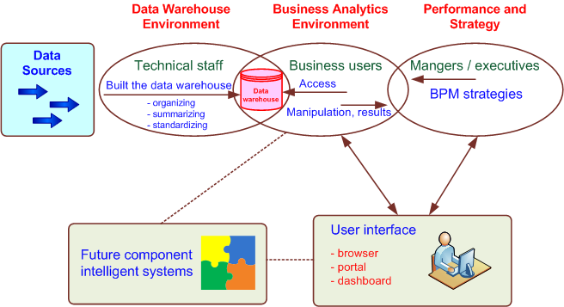
A High-level Architecture of BI

Slide 17
Components in a BI Architecture
The data warehouse is the cornerstone of any medium-to-large BI system.
Originally, the data warehouse included only historical data that was organized and summarized, so end users could easily view or manipulate it.
Today, some data warehouses include access to current data as well, so they can provide real-time decision support (for details see Chapter 2).
Business analytics are the tools that help users transform data into knowledge (e.g., queries, data/text mining tools, etc.).

Slide 18
Components in a BI Architecture
Business Performance Management (BPM), which is also referred to as corporate performance management (CPM), is an emerging portfolio of applications within the BI framework that provides enterprises tools they need to better manage their operations
User Interface (i.e., dashboards) provides a comprehensive graphical/pictorial view of corporate performance measures, trends, and exceptions.

Slide 19
Automated Decision Making
A relatively new approach to supporting decision making
Applies to highly structured decisions
Automated decision systems (ADS)
(or decision automation systems)
An ADS is a rule-based system that provides a solution to a repetitive managerial problem in a specific area.
e.g., simple-loan approval system

Slide 20
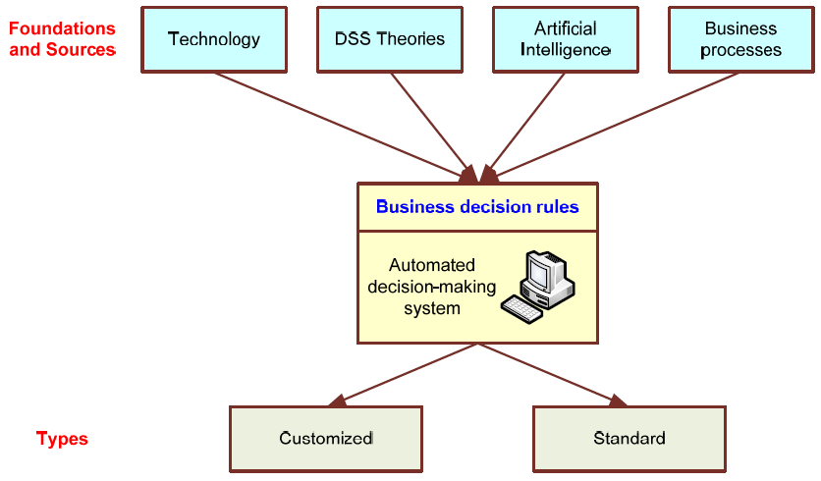
Automated Decision-Making Framework

Slide 21
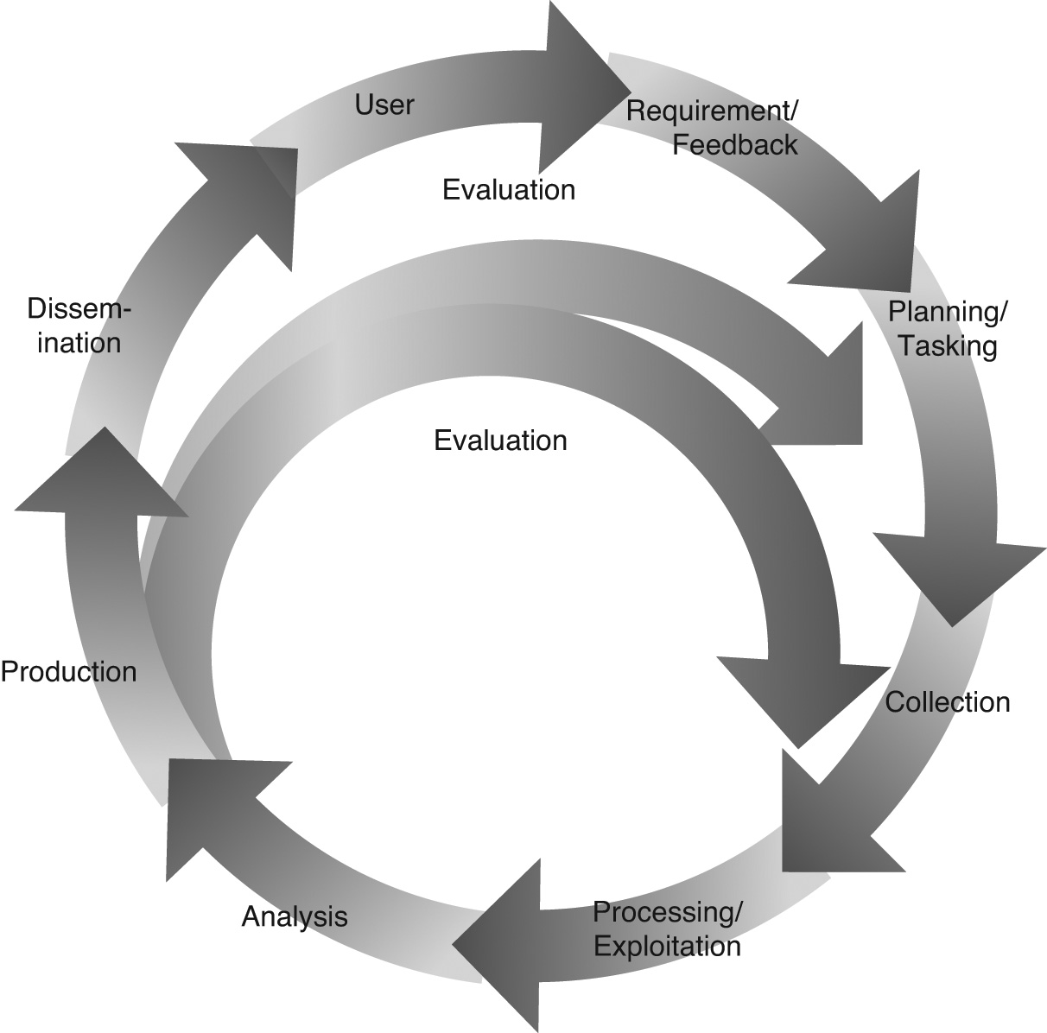
Intelligence Creation and Use
A Cyclical Process of Intelligence Creation And Use
BI practitioners often follow the national security model depicted in this figure.

Slide 22
Intelligence Creation and Use
Steps Involved
Data warehouse deployment
Creation of intelligence
Identification and prioritization of BI projects
By using ROI and TCO (cost-benefit analysis)
This process is also called BI governance
BI Governance
Who should do the prioritization?
Partnership between functional area heads
Partnership between customers and providers

Slide 23
BI Governance Issues/Tasks
Create categories of projects (investment, business opportunity, strategic, mandatory, etc.)
Define criteria for project selection
Determine and set a framework for managing project risk
Manage and leverage project interdependencies
Continuously monitor and adjust the composition of the portfolio

Slide 24
BI and Business Strategy
To be successful, BI must be aligned with the company’s business strategy.
BI cannot/should not be a technical exercise for the information systems department.
BI changes the way a company conducts business by
improving business processes, and
transforming decision making to a more data/fact/information driven activity.
BI should help execute the business strategy and not be an impediment for it!

Slide 25
Real-time, On-demand BI
The demand for “real-time” BI is growing!
Is “real-time” BI attainable?
Technology is getting there…
Automated, faster data collection (RFID, sensors,… )
Database and other software technologies (agent, SOA, …) are advancing
Telecommunication infrastructure is improving
Computational power is increasing while the cost for these technologies is decreasing
Trent -> Business Activity Management

Slide 26
Issues for Successful BI
Developing vs. Acquiring BI systems
Developing everything from scratch
Buying/leasing a complete system
Using a shell BI system and customizing it
Use of outside consultants?
Justifying via cost-benefit analysis
It is easier to quantify costs
Harder to quantify benefits
Most of them are intangibles

Slide 27
Issues for Successful BI
Security and Privacy
Still an important research topic in BI
How much security/privacy?
Integration of Systems and Applications
BI must integrate into the existing IS
Often sits on top of ERP, SCM, CRM systems
Integration to outside (partners of the extended enterprise) via internet –
customers, vendors, government agencies, etc.

Slide 28
Business Analytics

Slide 29
Introduction to Business Analytics
Business analytics uses historical and current data to make strategic and actionable decisions.
The types of decisions tend to factor in longer-term trends, and often involve a mix of statistical and trend analysis, alongside domain expertise and human judgment.
Business analysis is as much an art as it is a science.

Slide 30
Introduction to Business Analytics
Business analytics is actually a subset of a larger group of data-management disciplines called business intelligence—an infrastructure that facilitates the collecting, storing, and analyzing of data from business operations.
A business intelligence platform provides comprehensive business metrics in near real time so you can create performance benchmarks, spot market trends, increase compliance, and improve almost every aspect of your business.

Slide 31
Introduction to Business Analytics
Business analytics contributes to this effort by turning your company’s raw data into useful information for things like measuring performance, identifying trends, predicting outcomes, and more

Slide 32
Business Analytics Methodologies
Common methodologies used in business analytics include:
Data mining: sorting through large amounts of data to identify patterns and trends
Aggregation: the process of gathering and organizing data before analysis
Forecasting: analyzing historical data to estimate future outcomes
Predictive modeling: extracting information from data sets to identify patterns and extrapolate future trends
Data visualization: creating visual representations of data analysis, such as charts, tables, or graphs to help communicate the findings

Slide 33
Business Analytics Methodologies
Common methodologies used in business analytics include:
Data mining: sorting through large amounts of data to identify patterns and trends
Aggregation: the process of gathering and organizing data before analysis
Forecasting: analyzing historical data to estimate future outcomes
Predictive modeling: extracting information from data sets to identify patterns and extrapolate future trends
Data visualization: creating visual representations of data analysis, such as charts, tables, or graphs to help communicate the findings

Slide 34
Types of Business Analytics
Descriptive analytics answers the question “What happened?” It’s used to understand overall performance at an aggregate level, relying on historical data that has been combined or summarized from various sources
Diagnostic analytics also uses historical data, but addresses the question of why an occurrence or anomaly happened within your data
Predictive analytics determines what is likely to happen. It’s also based on historical data, but uses machine learning to understand patterns and trends
Prescriptive analytics merges the first three types of analytics to provide guidance toward a specific action to take, for example, proactively buying more parts for preventive maintenance

Slide 35
Types of Business Analytics
Descriptive analytics answers the question “What happened?” It’s used to understand overall performance at an aggregate level, relying on historical data that has been combined or summarized from various sources
Diagnostic analytics also uses historical data, but addresses the question of why an occurrence or anomaly happened within your data
Predictive analytics determines what is likely to happen. It’s also based on historical data, but uses machine learning to understand patterns and trends
Prescriptive analytics merges the first three types of analytics to provide guidance toward a specific action to take, for example, proactively buying more parts for preventive maintenance

Slide 36
Steps in Business Analytics’ Process
Define objectives: First, get clear on what you want to accomplish or which questions you want to answer. Your objectives might involve improving efficiency, increasing sales, cutting costs, understanding customer behavior, and so forth and will vary from business to business
Collect data: collect relevant data—from spreadsheets, customer interactions, website traffic, social media, and more. The quality of your data is critical; it should be accurate, relevant, and comprehensive enough to address your objectives

Slide 37
Steps in Business Analytics’ Process
Clean and prepare data: Raw data can be messy and contain errors, inconsistencies, and/or missing values hence cleaning and preparation is important.
This includes removing duplicates, correcting errors, supplying missing values, and formatting the data for analysis

Slide 38
Steps in Business Analytics’ Process
Analyze the data: Use of analytical techniques to uncover patterns, trends, correlations, and other insights.
This could involve descriptive analytics to summarize and describe the data, diagnostic analytics to understand why certain events occurred, predictive analytics to forecast future trends or outcomes, and prescriptive analytics to recommend actions based on the analysis

Slide 39
Steps in Business Analytics’ Process
Visualize the data: Through charts, graphs, dashboards, and other graphical representations, visualizing data helps communicate insights more effectively and makes it easier for stakeholders to understand the findings

Slide 40
Steps in Business Analytics’ Process
Interpret for decision making:
This means assessing the implications of the insights and making informed decisions based on the analysis.
These might involve changes to business strategies, processes, products, marketing campaigns, and so forth

Slide 41
Steps in Business Analytics’ Process
Implement and monitor:
Now that you’ve made decisions based on the analysis, they need to be implemented and the outcomes monitored.
This could involve tracking key performance indicators (KPIs) to measure the impact of the decisions and make adjustments as necessary

Slide 42
Tools in Business Analytics
Data collection tools: These gather data from sources like databases, spreadsheets, websites, social media platforms, sensors, and more. Examples include:
SQL (structured query language) for querying databases ETL (extract, transform, load) tools like Talend, Informatica, or Apache NiFi for data integration and transformation
Web-scraping tools like BeautifulSoup or Scrapy for extracting data from websites
APIs (application programming interfaces) for accessing data from online services and platforms

Slide 43
Tools in Business Analytics
Data storage and management tools: These store, organize, and manage large volumes of data.
Examples include:
Relational databases like MySQL, PostgreSQL, or Microsoft SQL Server
NoSQL databases such as MongoDB, Cassandra, or Redis for handling unstructured or semi-structured data
Data warehouses like Snowflake, Amazon Redshift, or Google BigQuery for storing and analyzing large datasets

Slide 44
Tools in Business Analytics
Data analysis tools: These are used to perform various types of data analysis, including descriptive, diagnostic, predictive, and prescriptive analytics. Examples include:
Statistical software like R or Python with libraries such as NumPy, Pandas, and SciPy for statistical analysis and modeling
Data mining tools such as IBM SPSS Modeler, RapidMiner, or Weka for discovering patterns and relationships in data
Machine learning frameworks like TensorFlow, Py Torch, or scikit-learn for building and deploying predictive models
Business intelligence platforms like Tableau, Power BI, or QlikView for creating interactive dashboards and reports

Slide 45
Tools in Business Analytics
Data visualization tools: These are used to create representations of data to facilitate understanding and decision making. Examples include:
Tableau for creating interactive dashboards and visualizations
Power BI for creating reports and dashboards with self-service analytics ggplot2 and matplotlib libraries in R and Python for creating customized static visualizations
D3.js for creating custom and interactive data visualizations on the web

Slide 46
Tools in Business Analytics
Collaboration and communication tools: Used to facilitate collaboration among team members and effectively communicate insights, these tools include:
Collaboration platforms like Slack, Microsoft Teams, or Trello for team communication and project management
Presentation software like Google Slides or Microsoft Powerpoint for creating and sharing presentations
Document sharing and collaboration tools like Google Drive or Microsoft Sharepoint

Slide 47
KPIs in Business Analytics
Financial Metrics
Customer Metrics
Operational Metrics
Marketing Metrics

